Slide 1

Knapsack Problem
In the final project, the problem we tried to solve is the knapsack problem. The knapsack problem is a NP-complete problem. We tried to find the value of the optimal solution using the approach of genetic algorithm.
Team #502
Zhao Jin
Zhuohang Feng
Chiwen Shi

Slide 2
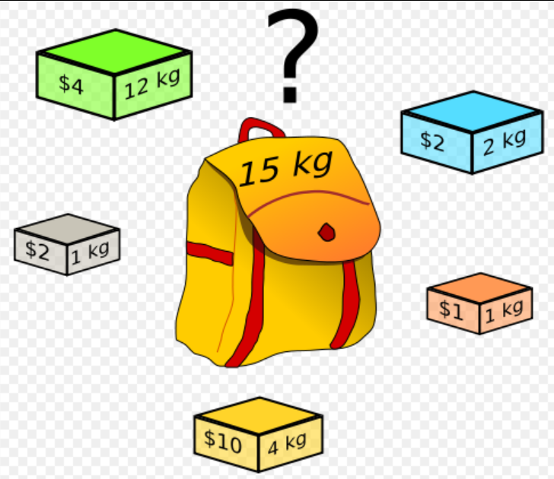
Part One
Problem Description & Approach
The knapsack problem is a problem in combinatorial optimization: Given a set of items, each with a weight and a value, determine the number of each item to include in a collection so that the total weight is less than or equal to a given limit and the total weight is less than or equal to a given limit and the total value is as large as possible. In other words, we are trying to fill a fixed-size knapsack with the most valuable items.

Slide 3
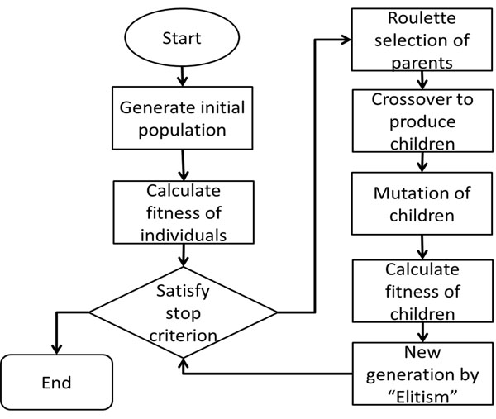
Approach: Genetic Algorithm

Slide 4
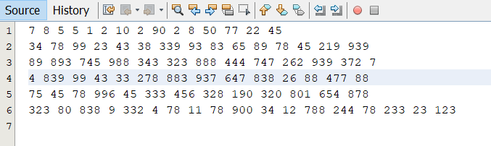
In
Part Two
Observations & Conclusions
Input Data: the input data will be put in an array which stores the weight and profit of every item. When the index is an even number, the data represents the weight of the item, when the index is an odd number, it represents the profit of the item. For example, 7 is the weight of the first item, 8 is the profit of the first item.

Slide 5
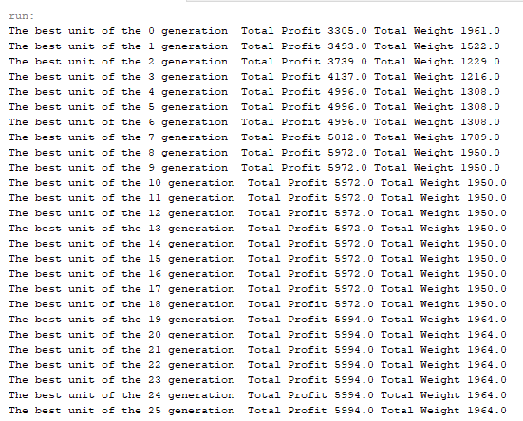
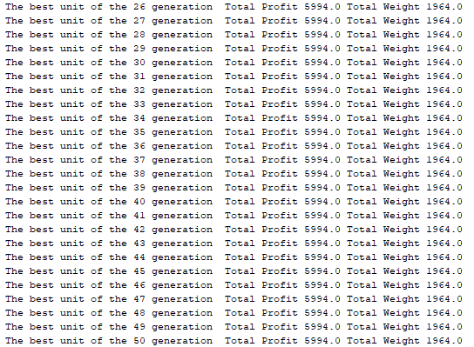
In
Part Two
Observations & Conclusions
The result of 1-25 generation:
The result of 26-50 generation:

Slide 6
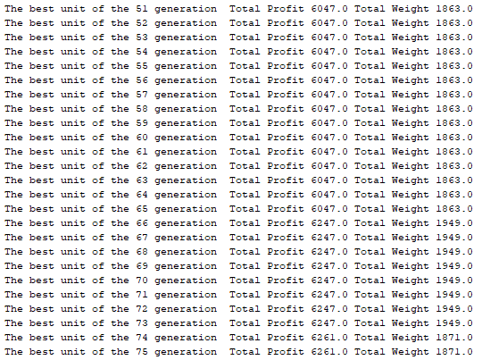
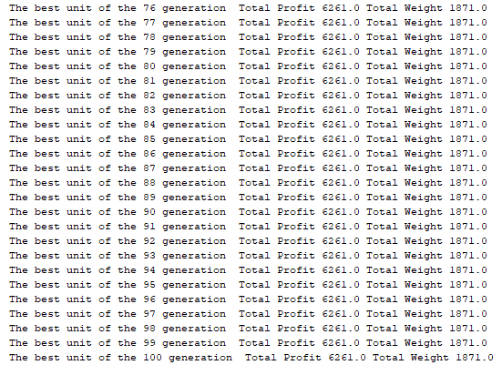
In
Part Two
Observations & Conclusions
The result of 51-75 generation:
The result of 76-100 generation:

Slide 7
In
Part Two
Observations & Conclusions
For this particular dataset, we got a stable result after the 74 generation. The optimal solution for this knapsack problem is that the total weight of the items we can fill with the fixed-size knapsack is 1871. The total profit, in other words, the maximum value we achieve is 6261.
There are many factors that can affect the convergence of Genetic Algorithm, such as the mutation rate and crossover rate and the rate of mutation of every digit of gene. We found that when all of these three rates are high, the convergence of GA is very slow.
We found that the result differs from each other when we try to run the main method, that means the optimal solution is different. The maximum profit of the items we can fill in the knapsack is different but they are all close to an ideal value. When the maximum generation is big enough, we can achieve the ideal condition. In the ideal condition will we get the optimal solution of the knapsack problem. The bigger the generation we iterate, the closer we get to the ideal value.

Slide 8
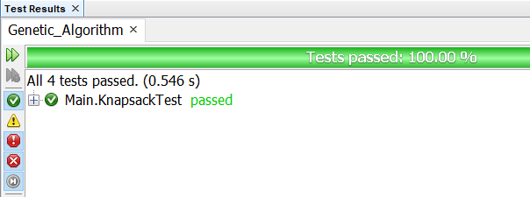
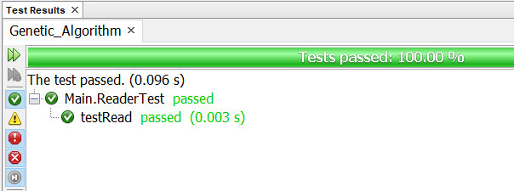
In
Part Three
Unit Tests
For the unit tests part, we have two test files, in order to test the main method knapsack and the reader class (from which we read the dataset).

Slide 9
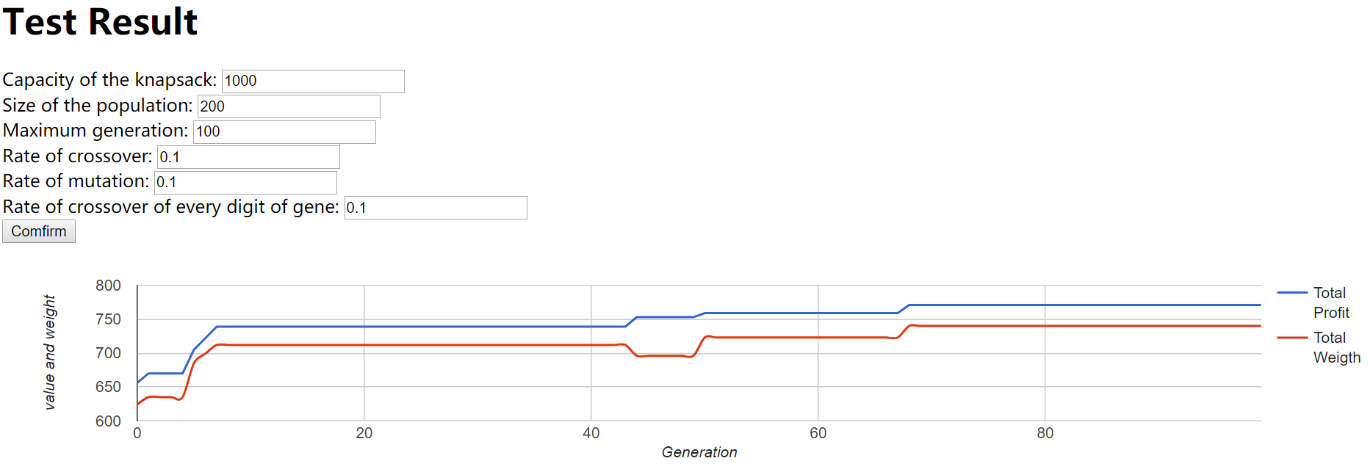
In
Part Four
User Interface Component
First, we used JavaServer Pages (index.JSP) to generate the front-end User Interface, and then used the Asynchronous JavaScript and XML (AJAX) technique to import the generated data(result.JSP). Then we achieved data visualization using the Google Chart API and got the diagrams we needed. Finally, we published our User Interface as a website through Azure.

